Slide 1
Comparison of Computational Models and Experimental Data for Common Pharma Reactions

Slide 2
Introduction
Objective and Scope of Research
objective
  assess methods for modeling the heats of reaction for various pharmaceutical reactions
  use in the future to model unknown reaction heats in industry
scope
  reactions studied: amide coupling, bromination, and debenzylation
timeline
  current research completed September – May
  research to be continued as a summer PMP project

Slide 3







Pharmaceutical Companies Involved
Collaboration and Contribution of Heat Values

Slide 4
Using TCIT vs CHETAH
TCIT
CHETAH
can be applied to any molecule
automatically detects and applies ring corrections
cannot currently calculate ions, such as NO₂ groups
python based program
  supports flexible data input (xyz, SMILE)
work in progress, consistent interaction with Qiyuan Zhao, PhD candidate
program licensed by ASTM that has been used for 47 years^{[1]}
widely known and used
  people experienced in adjusting reactions for satisfactory results
required use of Benson group substitutions
  increased variability of results
requires manual and limited ring corrections
does not account for placement of rings in structures

Slide 5
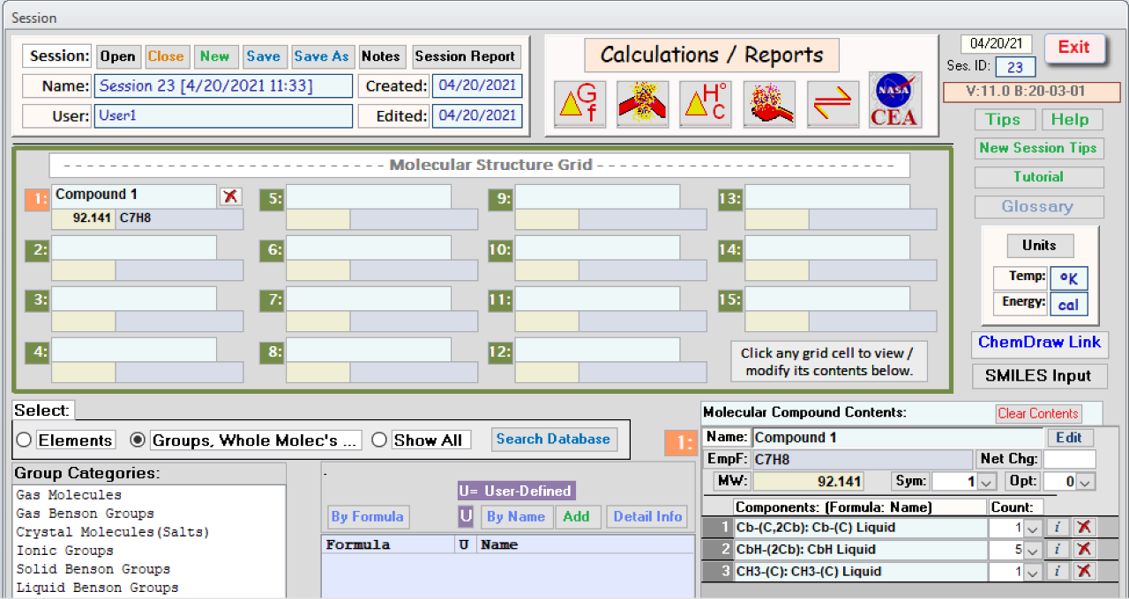
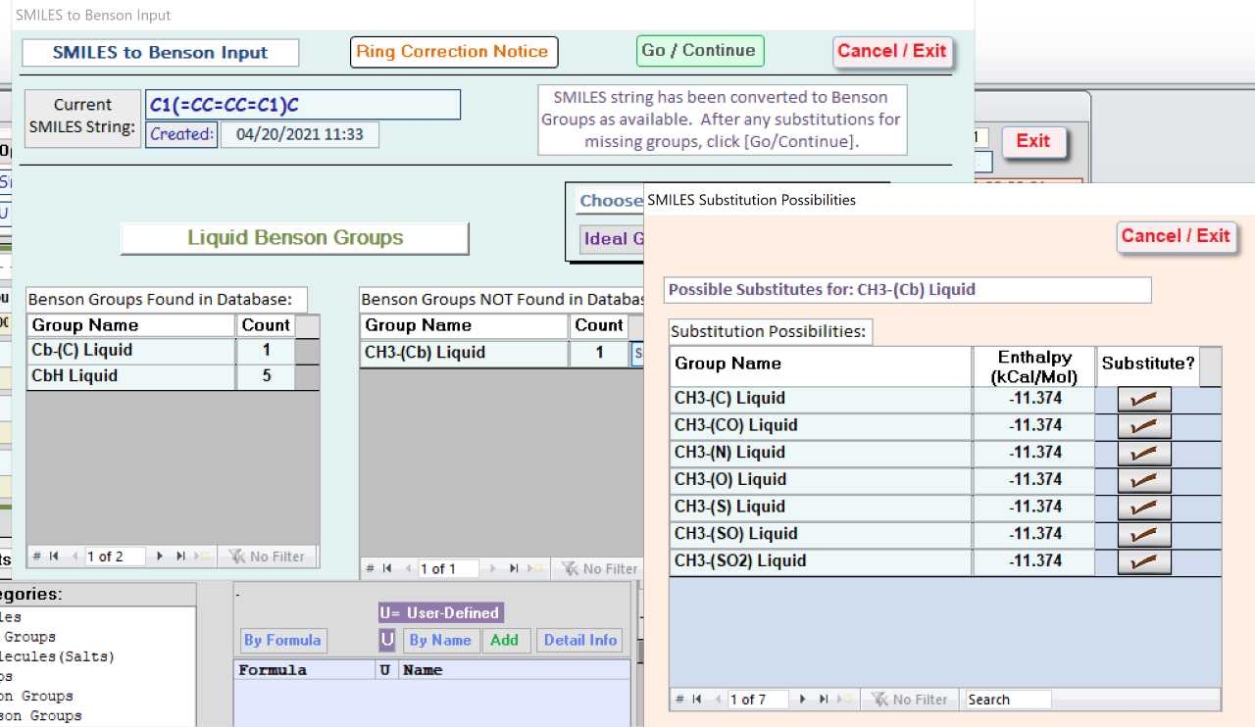
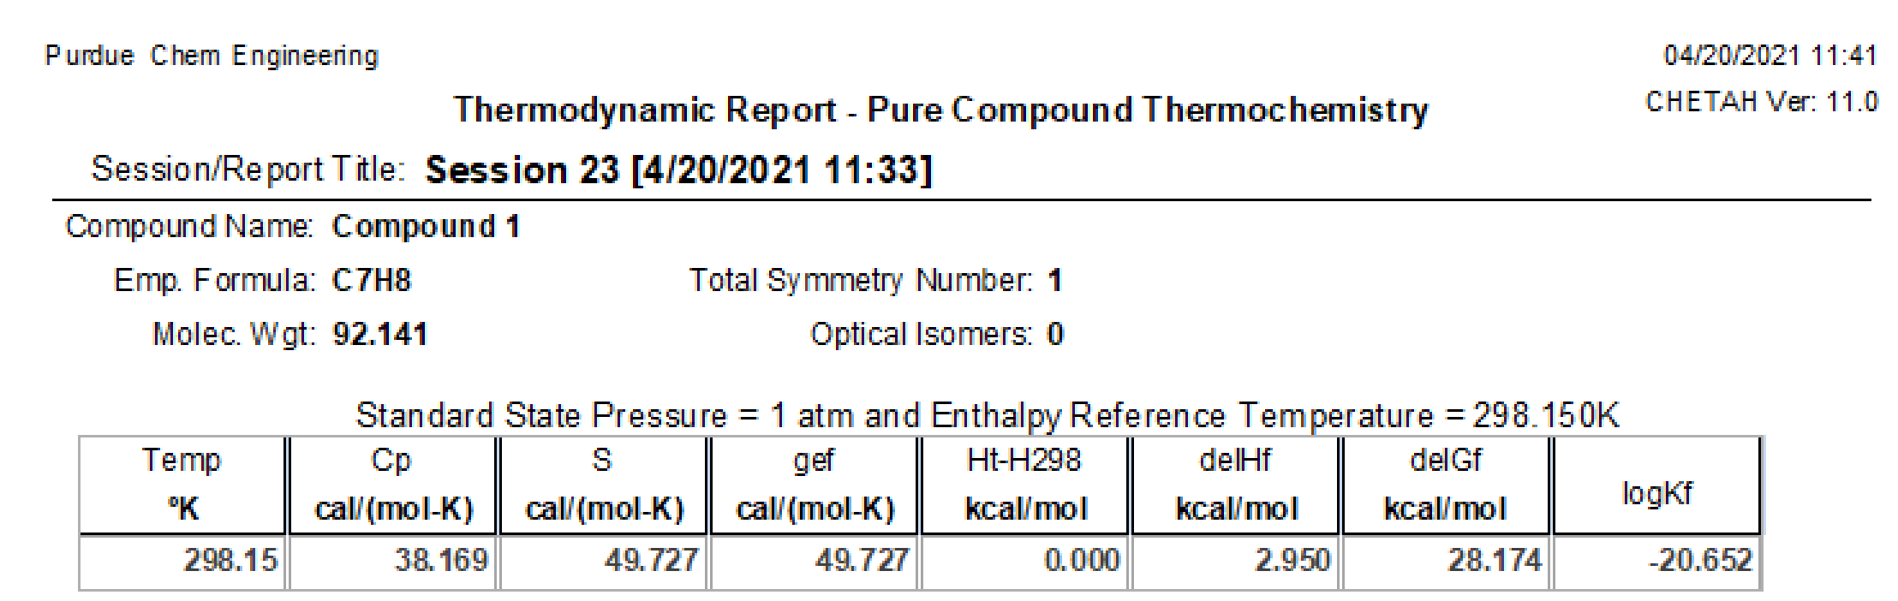
Result Outputs of Modeling Programs
CHETAH Results

Slide 6
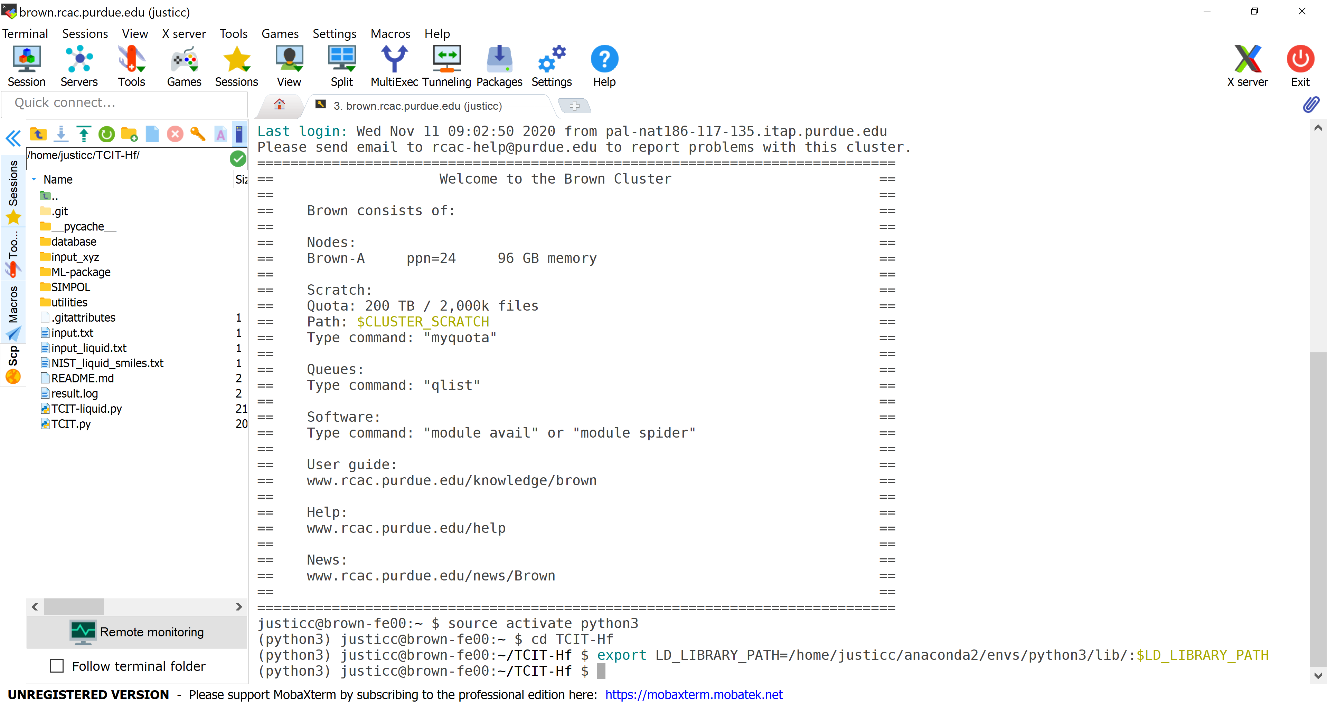
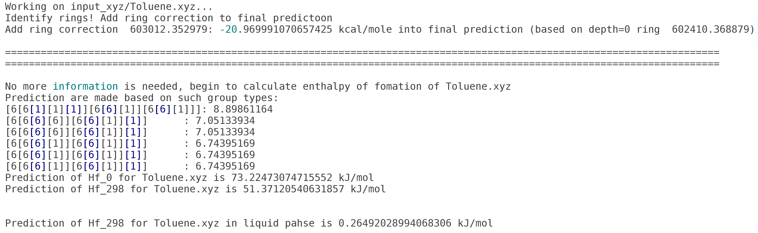
Result Outputs of Modeling Programs
TCIT Results

Slide 7
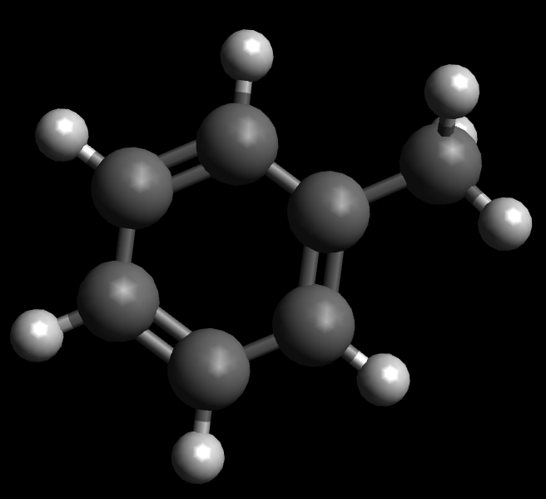
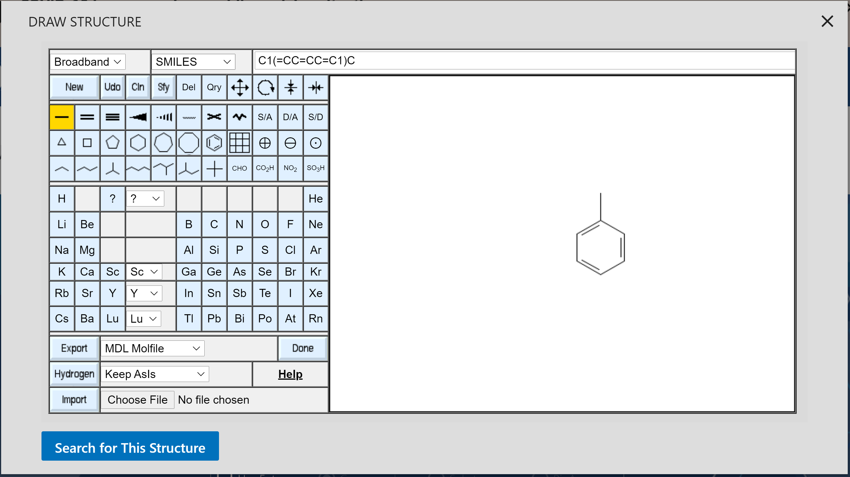

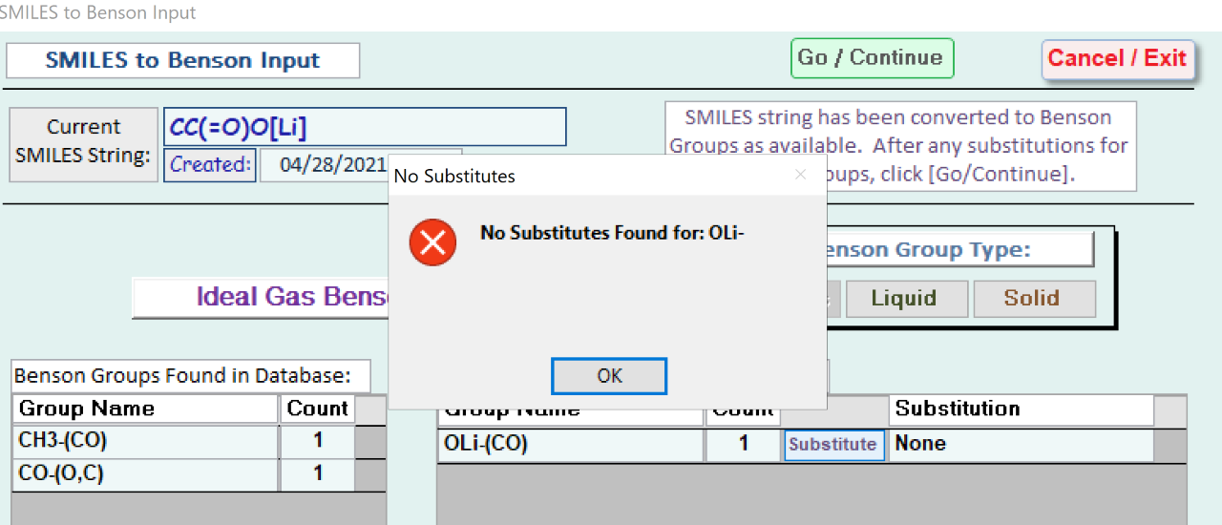
Complications of Modeling
Challenges in Accommodating Model Calculations
structure files and information
  Avogadro used for xyz file to upload to TCIT
  PubChem used to find SMILE string for CHETAH
reaction mechanism issues
  ions and radicals cannot currently be modeled in TCIT
  some Benson group substitutions do not exist in
  CHETAH
other reaction complications
  CHETAH limitations for radicals
  some salts from reactions cannot be modeled

Slide 8
Comparison of Simple Reaction Heats
Heat of Formation of Toluene
Method of Calculation | Heat of Formation (kJ/mol)
TCIT | 10.84
CHETAH | 12.34
NIST | 12.00 ± 1.1^{[2]}

Slide 9
Comparison of Complex Reaction Heats
Heat of Reaction of HATU Amide Coupling
Reaction | Phase | Measured ΔH_{rxn} (kJ/mol) | TCIT ΔH_{rxn} (kJ/mol) | CHETAH ΔH_{rxn}** (kJ/mol)
 | liquid | -159 | -130.9 | -125.6^{[3]}
 | liquid | -174 | -154.8 | -149.1^{[3]}
 | gas | -159* | -138.7 | -160.9
-56 kJ/mol added for acid-base reaction
*CHETAH calculation, not measured data
**corrected from gas to liquid phase

Slide 10
Comparison of Complex Reaction Heats
Heat of Reaction of HBTU Amide Coupling
Reaction | Phase | Measured ΔH_{rxn} (kJ/mol) | TCIT ΔH_{rxn} (kJ/mol) | CHETAH ΔH_{rxn}** (kJ/mol)
 | liquid | -127.1 | -141.0 | -136.5^{[3]}
-56 kJ/mol added for acid-base reaction
**corrected from gas to liquid phase

Slide 11
Comparison of Complex Reaction Heats
Heat of Reaction of TBTU Amide Coupling
Reaction | Phase | Measured ΔH_{rxn} (kJ/mol) | TCIT ΔH_{rxn} (kJ/mol) | CHETAH ΔH_{rxn}** (kJ/mol)
 | liquid | -123 | -109.6 | -125.0^{[3]}
 | liquid | -136 -174.4* | -149.8 | -173.1^{[3]}
 | liquid | -207 | -160.8 | -173.1^{[3]}
-56 kJ/mol added for acid-base reaction
*data from different companies with varying methods of measure
**corrected from gas to liquid phase

Slide 12
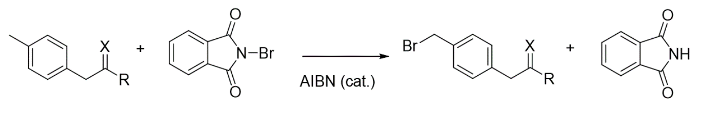
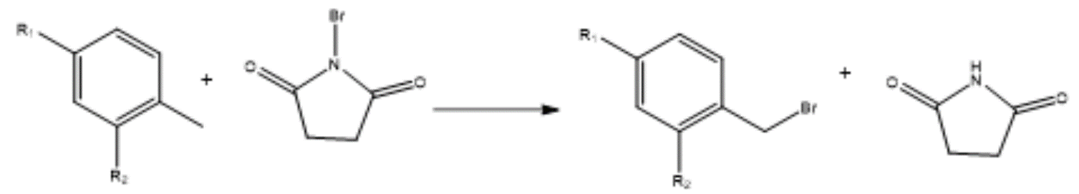
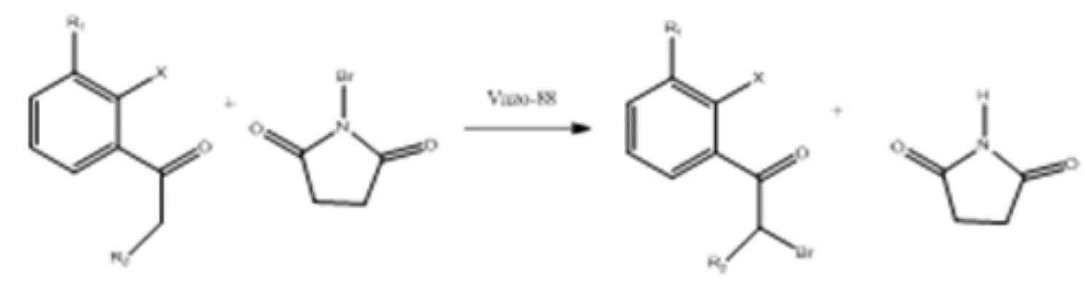
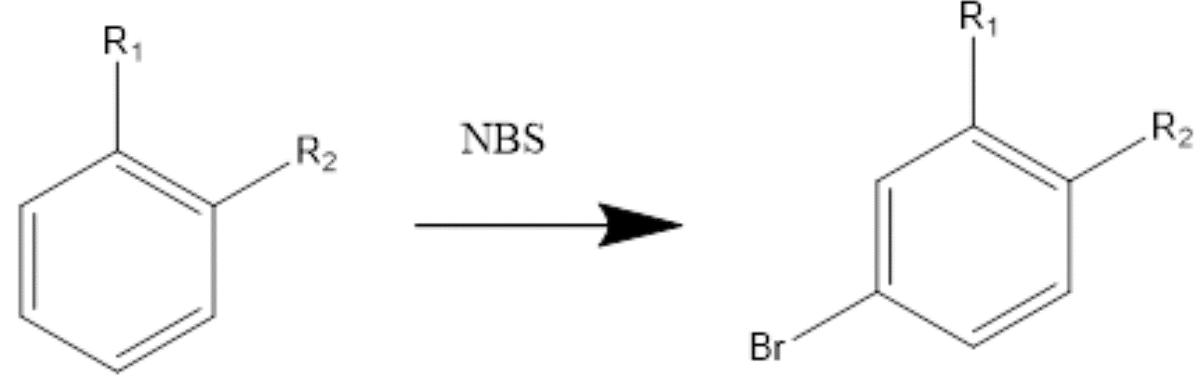
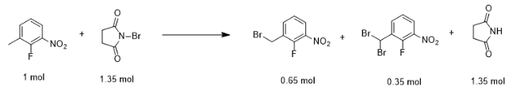
Comparison of Complex Reaction Heats
Heat of Reaction of Bromination
Reaction | Phase | Measured ΔH_{rxn} (kJ/mol) | TCIT ΔH_{rxn} (kJ/mol) | CHETAH ΔH_{rxn} (kJ/mol)
 | liquid | -106 | -128.8 | -90.84
 | liquid | -79 | -73.03 | -92.74
 | liquid | -79 | -73.89 | -95.69
 | liquid | -113 | -138.7 | -111.3
 | liquid | -136 | -122.7 | -137.2

Slide 13
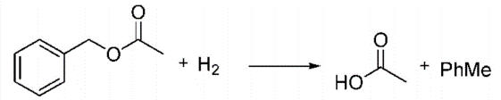
Comparison of Complex Reaction Heats
Heat of Reaction of Debenzylation
Reaction | Phase | Measured ΔH_{rxn} (kJ/mol) | TCIT ΔH_{rxn} (kJ/mol) | CHETAH ΔH_{rxn} (kJ/mol)
 | liquid | -114 | -89.09^{[4]} | -90.98^{[4]}
 | liquid | -210 | -189.3^{[4]} | -187.0^{[4]}
 | liquid | -116.1 | -103.1^{[4]} | -115.8^{[4]}
-9 kJ/mol added for H₂ adsorption

Slide 14
Comparison of Complex Reaction Heats
Types of Reactions Modeled
types of reactions compared
  amide coupling (HATU, TBTU, HBTU)
  bromination
  debenzylation
other common reaction types from companies not yet studied
  oxidation
  Grignard

Slide 15
Conclusions
Current Results of Research
some enhancements needed for TCIT
  less frequently used chemicals like Li and Br
optimization of CHETAH reactions can be done
  optimal Benson Group substitutions per experience
TCIT and CHETAH can predict the heat of reaction fairly well for reactions studied
  often within a 20% error of the measured value

Slide 16
Future Work
Continuation of Research
comparison of more reactions
  need additional experimental heat of reaction data to compare with calculations
  assess capability in calculation of reaction heats
    many components and mechanisms not tried
  limited coverage for lithium and bromine groups in TCIT
improvement in modeling reactions
  try various reaction mechanisms for potential improvement in calculated reaction heat
more heat reaction data required for comparison

Slide 17
Thank You
Are there any questions?

Slide 18
References
[1] Harrison, B. K. (2005). The Use of the ASTM Computer Program CHETAH as an Element in a Program to Prevent Reactive Hazards. Research Gate. doi:10.13140/RG.2.1.4035.4326.
[2] NIST Chemistry WebBook. (2018). Toluene - Condensed Phase Thermochemistry Data. Retrieved April 20, 2021, from https://webbook.nist.gov/cgi/cbook.cgi?ID=C108883&amp;Units=SI&am p;Mask=2#Thermo-Condensed.
[3] Weisenburger, G. A., Barnhart, R. W., Clark, J. D., Dale, D. J., Hawksworth, M.,
Higginson, P. D., . . . Tickner, D. L. (2007). Determination of Reaction Heat: A Comparison of Measurement and Estimation Techniques. Organic Process Research & Development, 11(6), 1112-1125. doi:10.1021/op700173h.
[4] Chou, P., and Vannice, M. A. (1987). Calorimetric Heat of Adsorption
Measurements on Palladium: Influence of Crystallite Size and Support on Hydrogen Adsorption. Journal of Catalysis, 104(1), 1-16. doi:10.1016/0021- 9517(87)90331-9.

